Slide 1
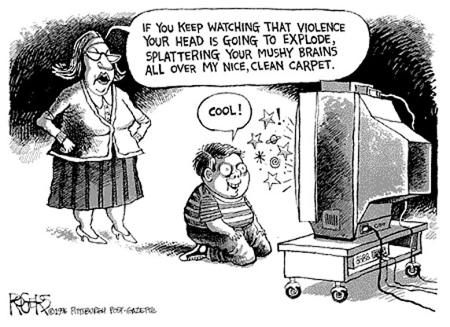
VIOLENCE
PREVENTION

Slide 2
FACT or FICTION
Unintentional Injuries Harm MORE People Than Intentional Injuries?
The Rate of Criminal Victimization in the U.S. is at an All Time High.
Suicides Take More Lives Than Homicides.
Children Are Safer From Violence After School Than While in School.

Slide 3
INTENTIONAL vs. UNINTENTIONAL
Injuries that are Purposely Inflicted Either By a Victim or Another Person.
ex. Homicide, Stalking, Rape, Hate Crimes
Injuries Having Occurred w/out Anyone’s Intending that Harm Be Done.
ex. Motor Vehicle, Residential/Home, Recreational
-Focus on Health, 2009

Slide 4
SCHOOL VIOLENCE
2003-2004
81% of U.S. Public Schools Reported at Least 1 Crime Incident.
77% of Schools Reported Instances of Physical Attacks or Fights w/out a Weapon.
51% Reported Vandalism
46% Reported Theft or Larceny
15% Reported Possession of a Knife or Sharpe Object
6% Reported a Student in Possession of a Firearm or Explosive Device.
-Focus on Health, 2009

Slide 5
HOMICIDE
Also Known As Murder
Intentional Taking of One Person’s Life by Another Person
U.S. Leads Industrialized World in Homicide Rates
2004, Homicide was 2nd Leading Cause of Death Amongst 15-24 Year Olds
-Focus on Health, 2009

Slide 6
SUICIDE
Inflicting Injury or Harm onto Oneself
Results in Fatality
Majority of Suicidal People Have Depressive Disorders or Feel Helpless Over Their Lives
Women are 3x’s More Likely Than Men to Attempt Suicide
-Focus on Health, 2009

