Slide 1

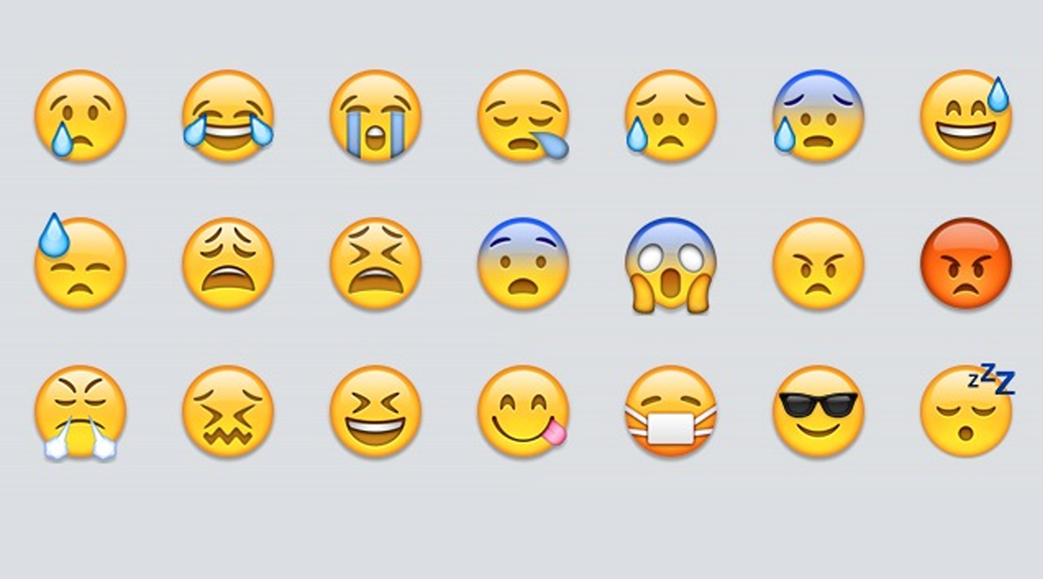
STUDENTS WILL BE ABLE TO:
2.1.8.D.1: INVESTIGATE CURRENT & EMERGING METHODS TO DIAGNOSE & TREAT DISEASES & HEALTH CONDITIONS.
2.1.8.D.5: INVESTIGATE VARIOUS FORMS OF MENTAL ILLNESS SUCH AS GAMBLING, SHOPPING, DEPRESSION, EATING DISORDERS, & BIPOLAR DISORDERS.
2.1.8.F.6: DESCRIBE SITUATIONS THAT MAY PRODUCE STRESS, DESCRIBE BODY’S RESPONSE TO STRESS, & DEMONSTRATE HEALTH WAYS TO MANAGE STRESS.

Slide 2
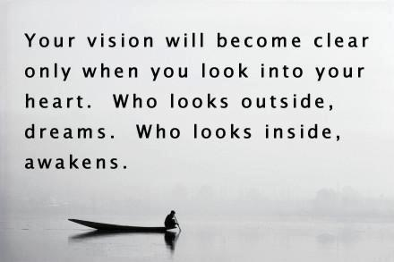

Slide 3

DEFINING GOOD or POSITIVE MENTAL HEALTH
The ABSENCE of Diagnosable Mental Health Problems
Person’s Ability to Fulfill Key Functions and Activities such as:
Learning
Feeling
Expressing Positive & Negative Emotions
Form and Maintain Good Relationships Cope w/ Change and Uncertainty
http://www.mentalhealth.org.uk

Slide 4
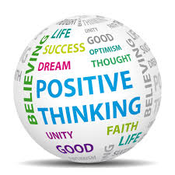
WHY STAY POSITIVE?
ACCORDING TO MENTAL HEALTH.NET- RESEARCH SHOWS
PESSIMISTS Have a Nearly 20% HIGHER RISK of DYING Over a 30-Year
Period vs. OPTIMISTS
Those Who Keep Track of Their GRATITUDE 1/Week = More Upbeat; Fewer
Physical Complaints
People Who Obsessively Repeat NEGATIVE Thoughts & Behaviors Were Able
to Change Unhealthy Patterns; Brain Activity Actually Changed

Slide 5
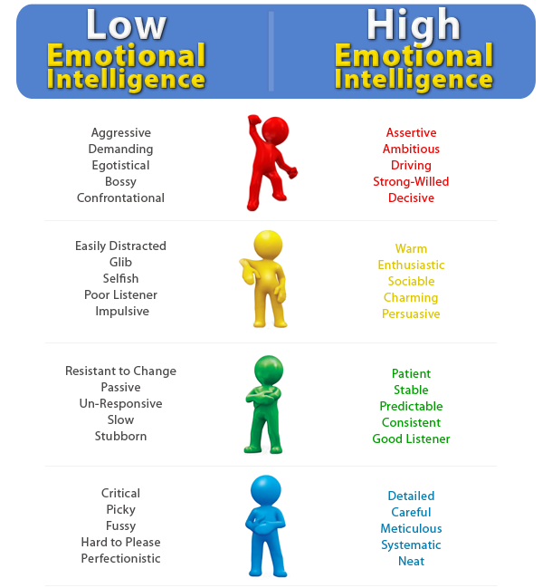

Slide 6
HOW TO STAY POSITIVE
FOSTER OPTIMISM
ex. Write About a Positive Future, Find “Silver Lining”
PRACTICE GRATITUDE
ex. Share Good News, Write in a “Gratitude Journal
AVOID NEGATIVE THINKING
ex. Ask Yourself if Problem is Something to Worry About; Try Problem Solving Strategies, Distract Yourself

Slide 7
VISION BOARD PROJECT
“A Vision, by Definition, is the Act or Power of Anticipating that which WILL or MAY Come to Be”
On Small Cork Board, Students Will “Illustrate” Personal Vision for THEIR FUTURE by Creating Their Very Own VISION BOARD.
Students May Use Photos, Magazine Clippings, Quotes, Drawings, or other Materials to Express Personal Journey or Goals.
Purpose of Project is to Demonstrate Another Mean of Promoting Positive Mental Health in a Fun, Unique Way.
http://dictionary.reference.com/browse/vision

