Slide 1
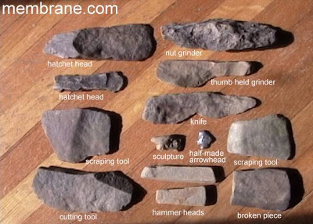
Chapter 2 The Stone Age and Early Cultures
Unit I:Early Humans and Societies
By Mr. Zindman

Slide 2
Chapter 2: The Stone Age and Early Cultures
Essential Question:
How did humans’ ways of living change as they interacted and adapted to their world?
Section 1: Studying History
The Big Idea
Prehistoric: people learned to adapt to their environment, to make simple tools, to use fire, and to use language.
Why is the invention of fire so important?

Slide 3
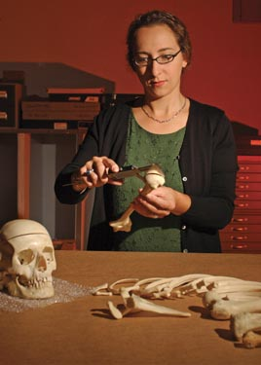
Scientists Study Remains
Although humans lived for more than a million years, writing was not invented until 5000 years ago.
Historians call the time before there was writing prehistory.
To study prehistory, historians rely on the work of archeologists and anthropologists.
An anthropologist is someone who studies cultures and their origins or where they came from.

Slide 4
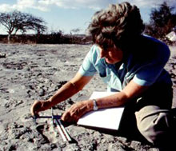
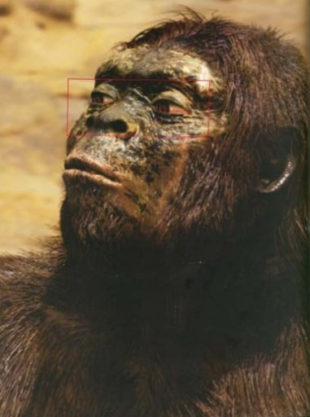
Mary Leaky, and archeologist discovered some bones in East Africa that were more than 1.5 million years old.
Mary Leaky believed the bones belonged to and early hominid, which she called, “Lucy.”
A hominid is an early ancestor to human beings.
An ancestor is a relative that lived in the past.

Slide 5
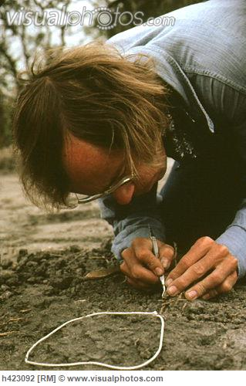
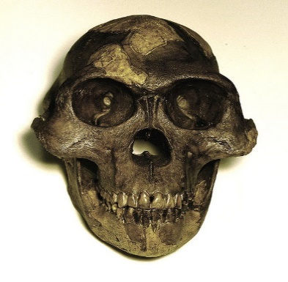
One of the key steps in human development was the ability to walk freely on two legs.
1n 1994 another anthropologist, Tim White found even older remains. The hominid he discovered lived more than 4.4 million years ago. Discoveries of ancient bones gives us information about the early humans and their ancestors.

Slide 6
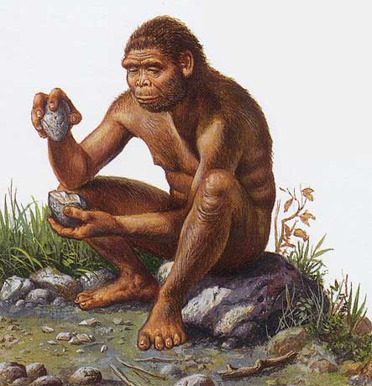
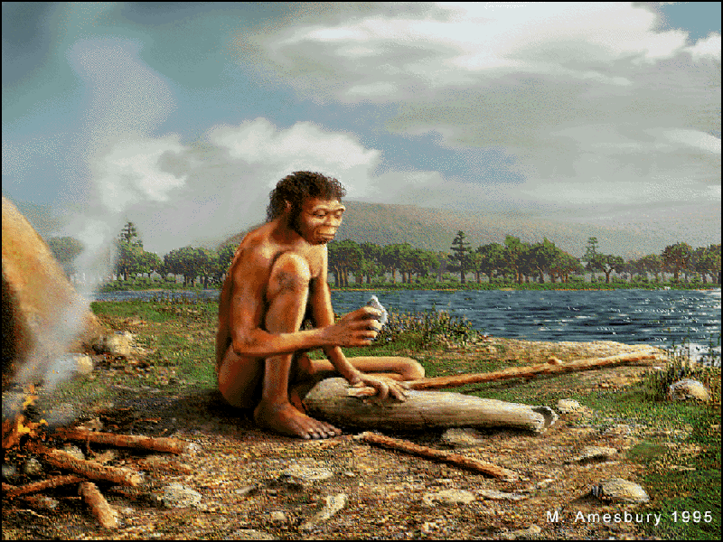
Hominids and Early Humans
In the early 1960’s Louis leaky found hominid remains that he called Homo habilis or “handy man.” Louis believed that his Homo habilis was more closely related to humans than Lucy because it had a larger brain.
Scientists discovered another group of hominids in Africa, called Homo erectus, or “upright man.”
Scientists believed that the Homo erectus hominid walked completely upright of straight.

Slide 7
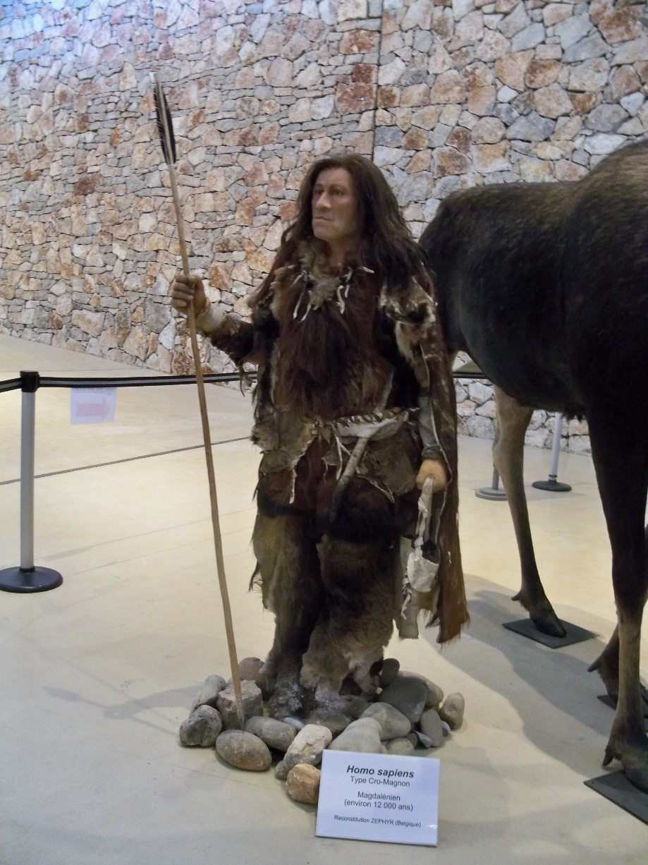
Eventually hominids developed characteristics of modern humans. Many scientists think the first modern human appeared in Africa about 200, 000 years ago. Scientists call these modern humans Homo sapiens, or “wise man.”
Every person alive today belongs to this group. We are all Homo sapiens.

Slide 8
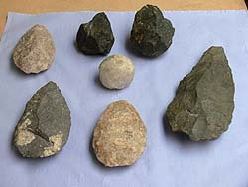
The first humans and their ancestors lived during a long period of time called the Stone Age.
Stone Age Tools
To help in their studies archeologists divided the Stone Age into periods based on the kinds of tools they used at the time.
To archeologists, a tool is any hand held object that has been modified to help a person accomplish a task.
The first part of the Stone Age is called the Paleolithic Era, or the Old Stone Age. During this time people used stone tools.

Slide 9
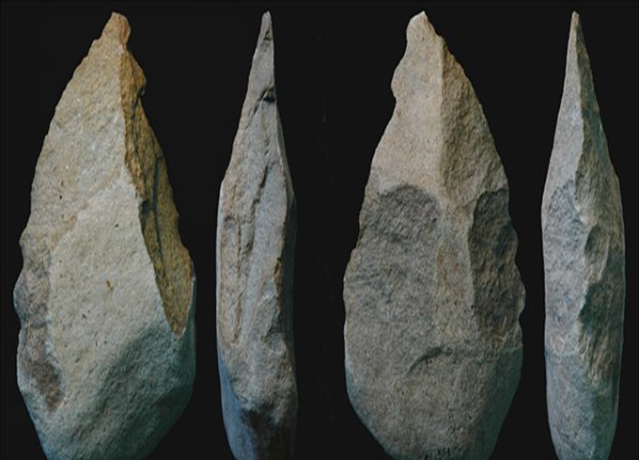
The First Tools
Scientists found the oldest tools Tanzania, a country in East Africa. These sharpened stones, the size of a fist, are about 2.6 million years old. Each stone had one side sharpened by another stone. One side was left unsharpened to use as a handle. Scientists believe these tools were used to process food. The sharp edge was used to cut, chop, or scape roots bones or meat. Scientists called these tools choppers.

Slide 10
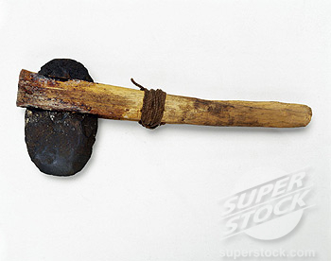
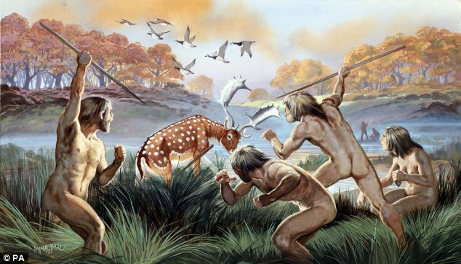
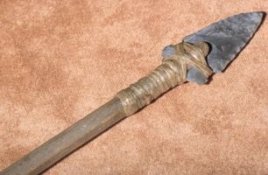
Later Tools
Over time people learned to make better tools. For example, they developed the hand ax.
The hand ax was made from flint stone and was used to break tree limbs, to dig, and to cut animal hides.
People also learned to attach handles to tools. By attaching a wooden shaft they were able to invent the spear.
Because the spear could be thrown, hunters no longer had to stay close to animals they were hunting.
They could also hunt larger animals.. Now they could hunt deer, horses, bison, and elephant like creatures called mammoths.

Slide 11
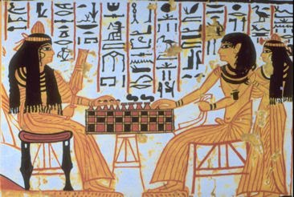
Hunter-gatherer Societies
As early humans develop tools and new hunting techniques, they formed societies.
A society is a community of people will share a common culture.
These societies developed cultures with languages, religions, and art.

Slide 12
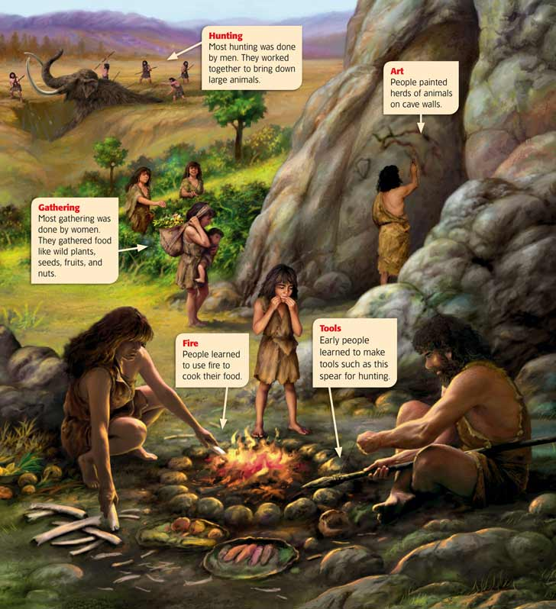
The early humans of the Stone Age were hunter-gatherers-people who hunt animals and gather wild plants, seeds, fruits, to survive.
Anthropologists believe that most stone age hunters were men. They hunted in groups, sometimes chasing entire herds of animals are over cliffs.
Women in the hunter-gatherer societies probably took the responsibility of collecting plants to eat. They also took care of children.

Slide 13
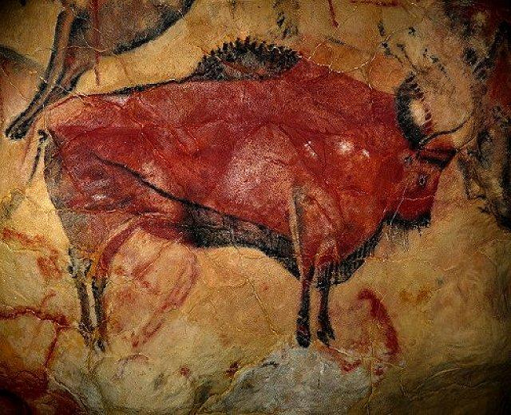
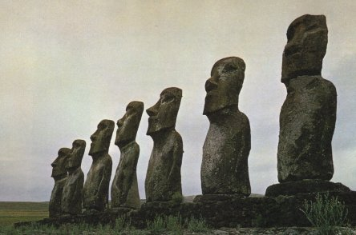
Language, Art, and Religion
Language made it easier for people to resolve issues like how to distribute food.
People also expressed themselves by creating art. People carved figures out of stone, ivory, and bone. They painted and carved images of people and animals on cave walls.

Slide 14
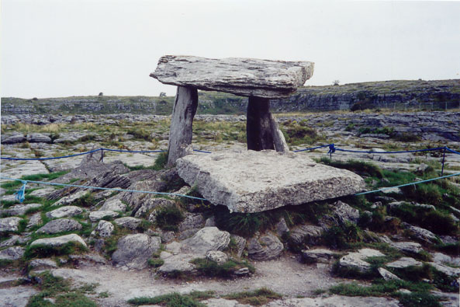
Scholars know little about the religious beliefs of early people. Archaeologists have found graves that include food and artifacts. Many scientists think these discoveries are proof that the first human religions developed during the Stone Age.

Slide 15
The Iceman
Why was a Stone Age traveler in Europe’s highest mountains?
When does he live? About 5000 years ago.
Where does he live? The frozen body of the iceman was discovered in the snowy will Otztal Alps in Italy and 1991.
Click on the iceman to view a 43 minute video on the Iceman.
What did he do? He was traveling. An arrowhead was found in his shoulder. After he died, his body was covered by glaciers and preserved the thousands of years.
Why is he important? The iceman is the oldest mollified humans ever found in such good condition. His body, clothing, and tools were extremely well as preserved, telling us a lot about life during the Stone Age.

Slide 16
Section 2 -Early Human Migration
The Big Idea
The development of agriculture brought great changes to human society.
Tribes of hunter-gatherers has lived in a place along as anybody can remember. But now there are not enough animals for your tribe to hunt. Your leaders say you have to move to a new home. How would you feel about moving to a new home?
During the Old Stone Age, climate patterns around the world changed, transforming the earth’s geography.
In response climate changes, people began to migrate, or move, to new places.
What would you do to protect yourself from a hurricane?

Slide 17
The Ice Ages
1.6 million years ago many places around the world began to experience long periods of freezing weather. These freezing times were called the Ice Age.
During the Ice Age is huge sheets of ice covered much of the earth’s land. Many land areas that were under water became exposed so that people could travel in order to find food and shelter.

Slide 18
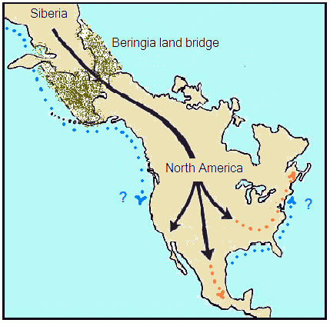
The land bridge, or a strip of land connecting two continents became available for people when water receded.
Land bridge is allowed people to migrate around the world.
Hint: The next slide will show you of migrations that people traveled.

Slide 19
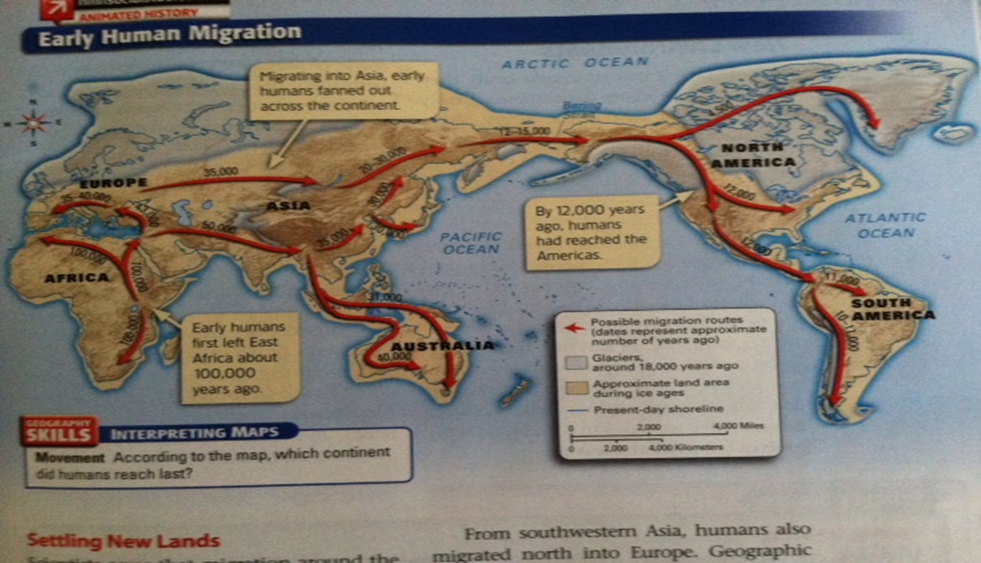
Settling New Lands
Human migration took hundreds of thousands of years. Early humans migrated from Africa to Asia as early as two million years ago. From there, they spread to Southeast Asia and Europe.
By 9000 BC, humans lived on all continents of the world except Antarctica.

Slide 20
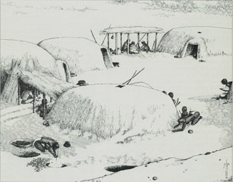
People Adapted to New Environments
Early people had to learn to adapt to their new environments. Many places were much colder and had strange plants and animals.
Fires were not enough to keep one, people had to learn to sew animal skins together to make clothing.
In addition to clothing, people need shelter to survive. If caves were not available, people built their own shelters. The first human made shelters were called pit houses.
A pit house was a pit in the ground with roofs of branches and leaves.
Later people began making houses above ground and animal skins and wood.

Slide 21
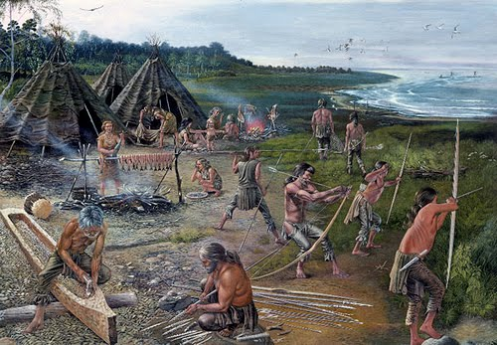
New Tools And Technologies
People adapted to their new environments by creating new types of tools. These tools are more complex and smaller than the Old Stone Age. They defined the Mesolithic Era, as the Middle Stone Age.

Slide 22
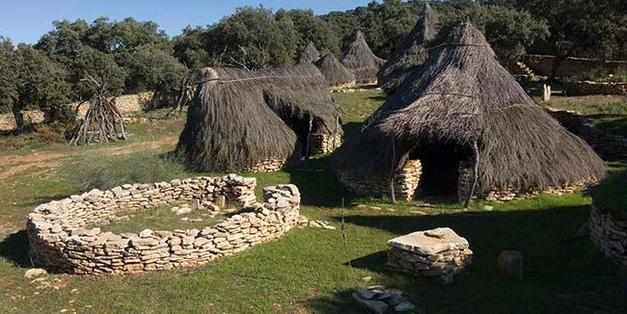
Section 3 –Beginnings of Agriculture
The Big Idea
The development of agriculture brought great changes to human society. How did the invention of farming change the world?
The First Farmers
After the Middle Stone Age came of period of time that scientists is called the Neolithic Era, or New Stone Age.
It began as early as 10,000 years ago in southwest Asia.

Slide 23
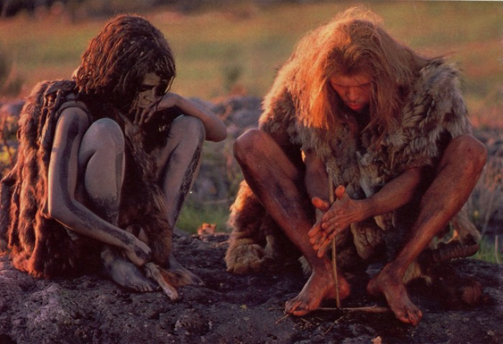
During the New Stone Age people learn to polished stones to make tools like so laws and rules. People also learned how to make fire.
Before, they can only use fire that has been started by natural causes such as lightning
The New Stone Age and date in Egypt and Asia about 5000 years ago, when toolmakers began to make tools of metal.

Slide 24
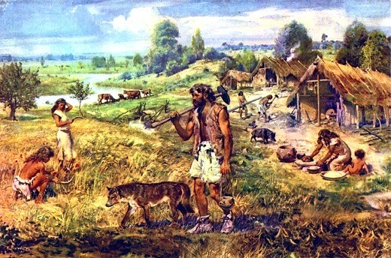
Plants
The biggest changes came in how people produced food in the New Stone Age. After to the Ice Age, a warming trend brought new plants to some areas. For example, wild barley and wheat plants started to grow throughout Asia.
People learned that they could plant seeds themselves to grow their own crops.
Historians call the shift from food gathering to food producing the Neolithic revolution

Slide 25
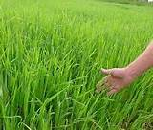
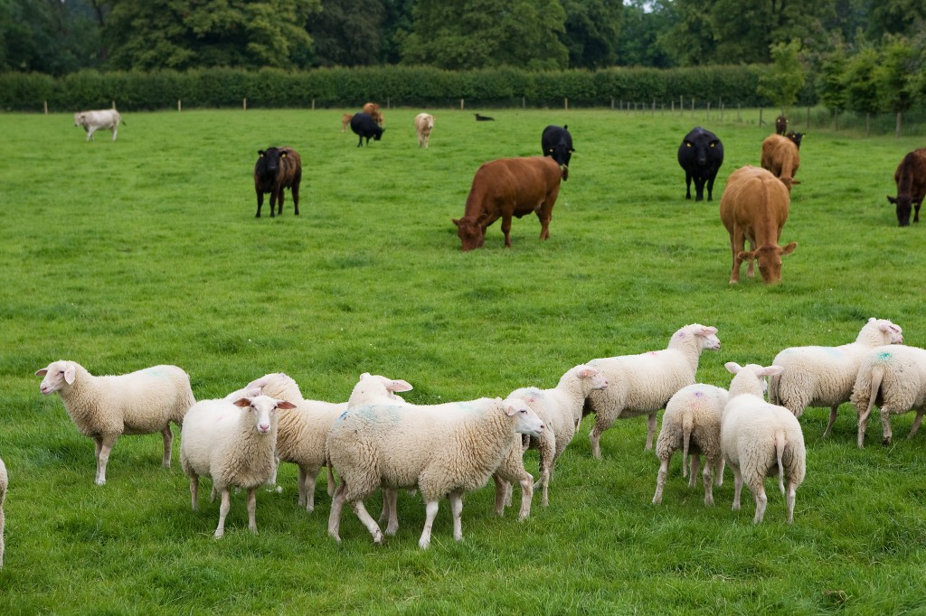
People learned to change plants to make them more useful. They planted only the largest grains for the sweetest fruits.
The process of changing plants or animals to make them more useful to humans is called domestication
The domestication of plants led to the development of agriculture, or farming.

Slide 26
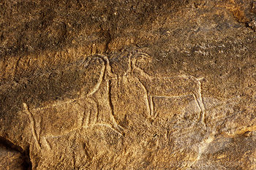
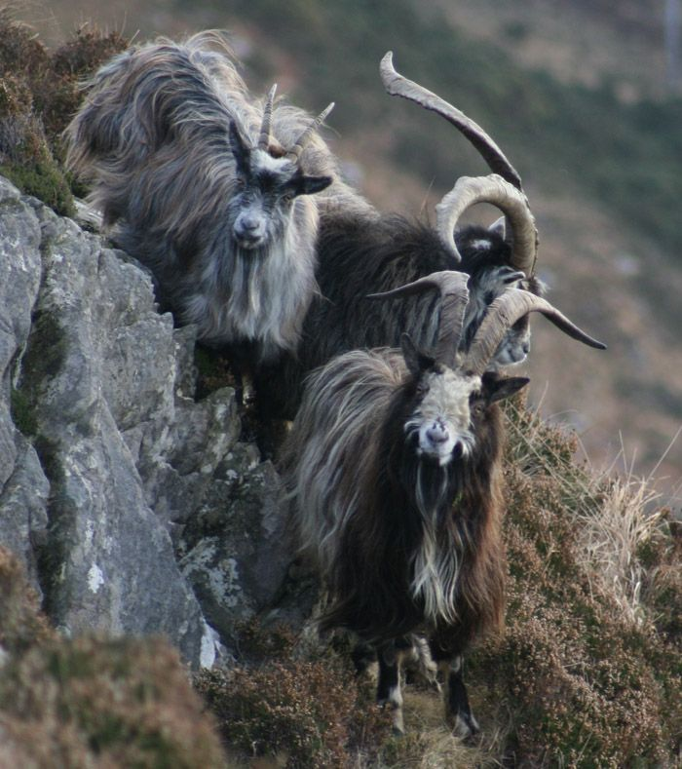
Animals
Learning how to use animals for their own purposes was equally important for people. Hunters did not have to follow wild herds anymore. Instead, farmers could keep sheep and goats or milk, food, and wool. Farmers could also use large animals to pull large tools for farming.

Slide 27
Farming Changes Societies
Domestication of plants and animals enabled people to use plant fibers to make cloth.
People began to build permanent settlements. As they started raising crops and animals, they needed to stay in one place.
Once people were in control of their own food production, the world’s population grew. In some areas farming communities developed in towns.

Slide 28
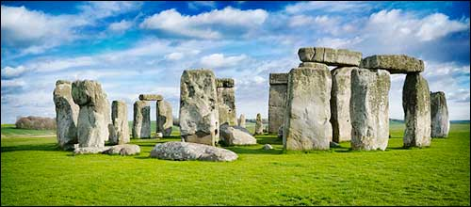
As populations grew, people gathered to perform religious ceremonies.
Some put up megaliths. Megaliths are huge stones use as monuments or the sites for religious gatherings
Early people probably believed in gods and goddesses associated with the four elements – air, water, fire, and earth- or with animals.
People in some societies today still hold many of the same beliefs.

Slide 29
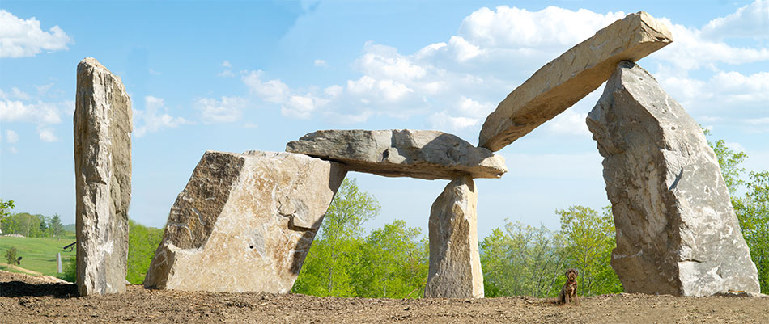
The End

